Slide 1
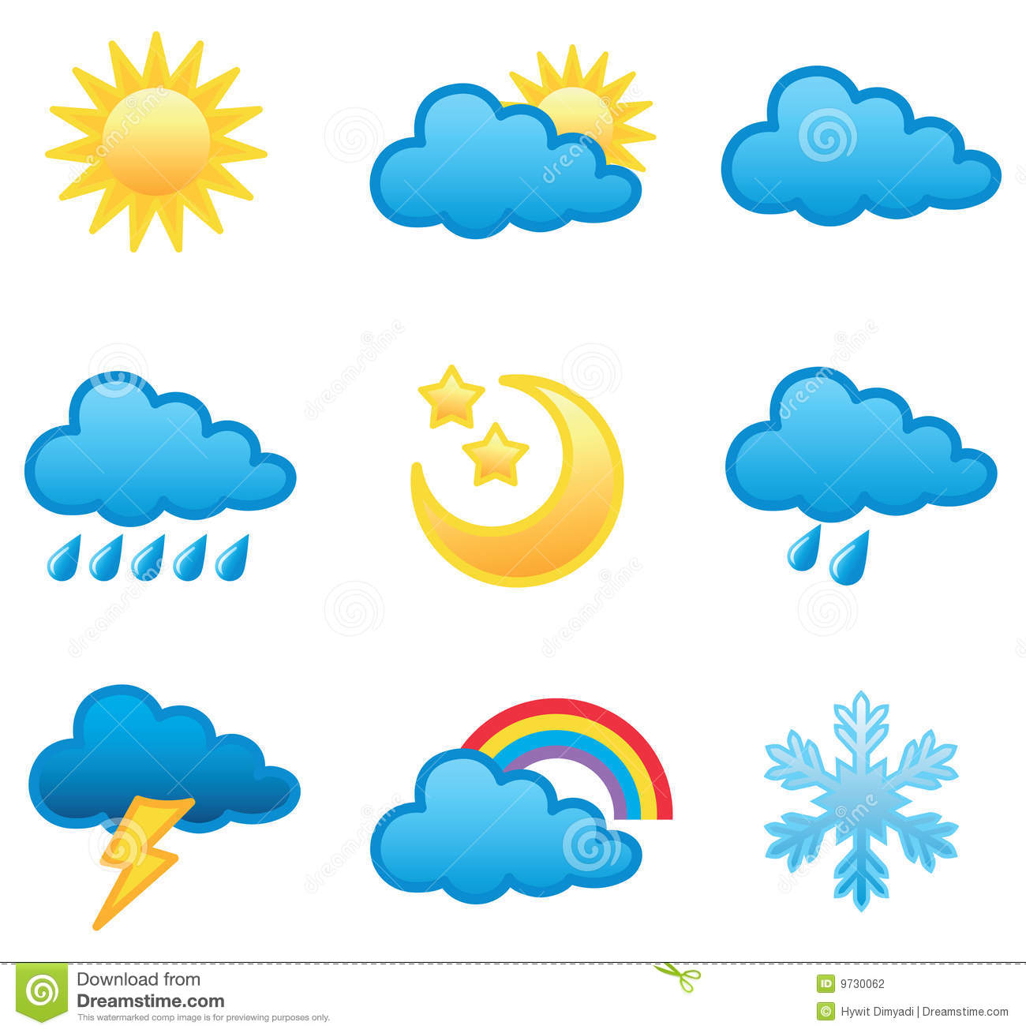
WEATHER
&
CLIMATE

Slide 2
Weather?
The state of the atmosphere at a PARTICULAR time and place
Climate?
The state of the atmosphere in a particular region over a LONG period of time

Slide 3
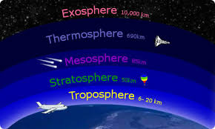
The atmosphere

Slide 4
The ATMOSPHERE is the gaseous layer around the Earth.
It’s divided into different layers. The layers closer to the Earth’s surface are thicker.
Layers: Troposphere, Stratosphere, Mesosphere, Thermosphere, Exosphere.

Slide 5
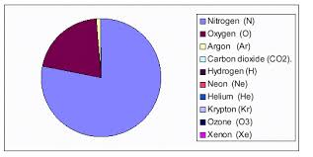
Ingredients

Slide 6
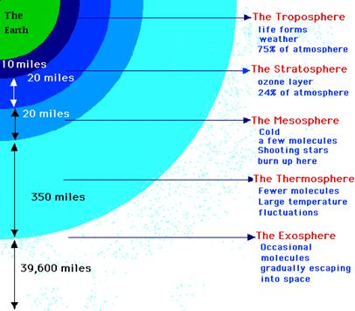

Slide 7
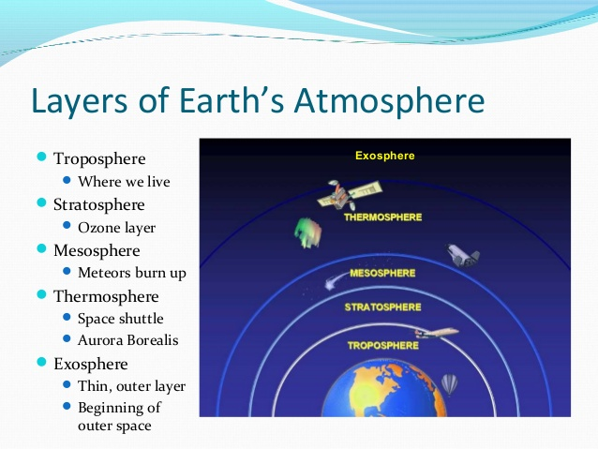

Slide 8
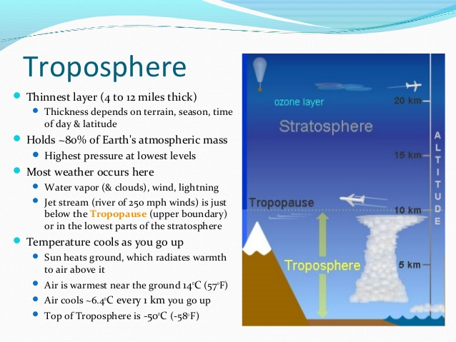

Slide 9
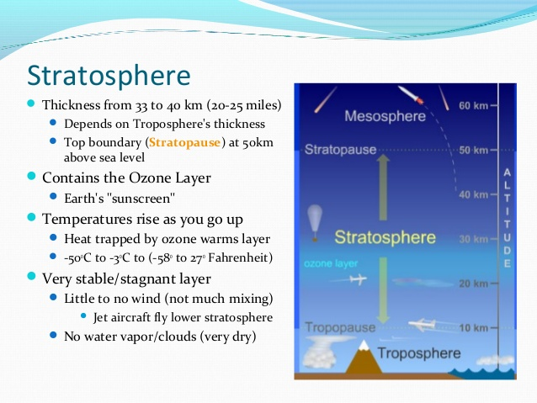

Slide 10
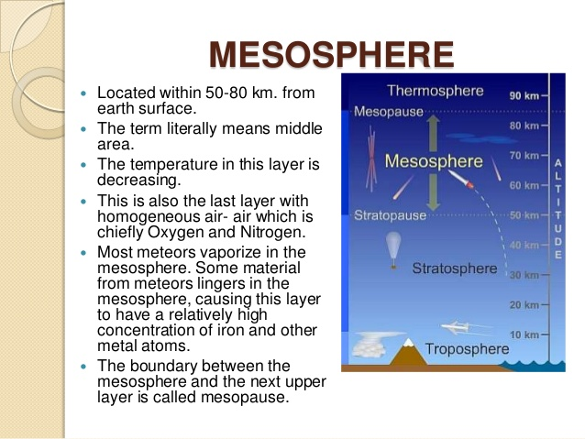

Slide 11
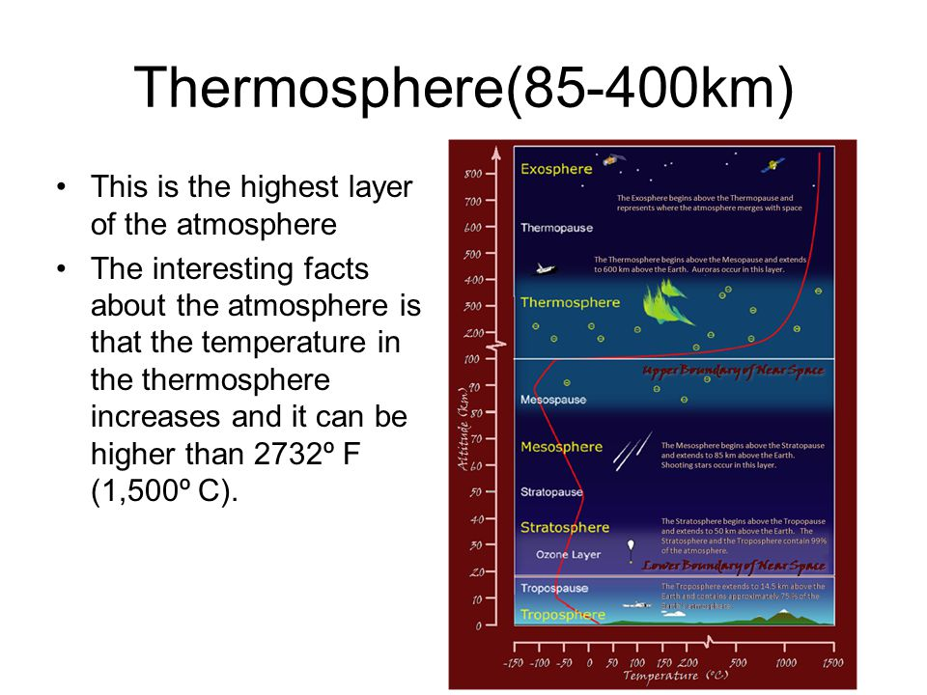

Slide 12
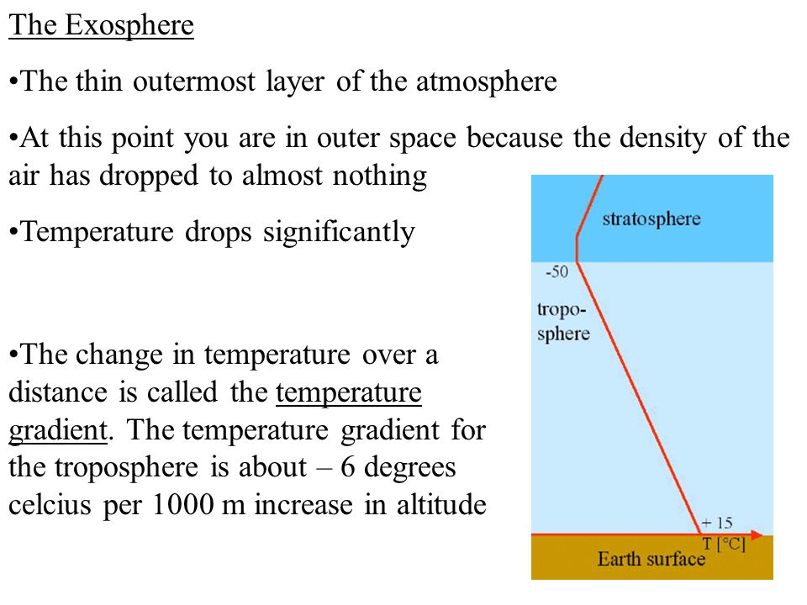

Slide 13
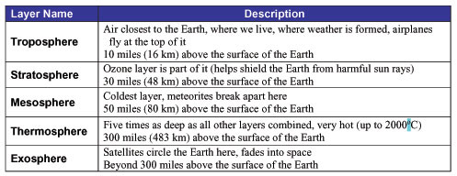
SUMMARY

Slide 14
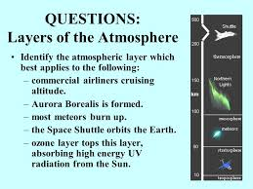
Your turn now

Slide 15
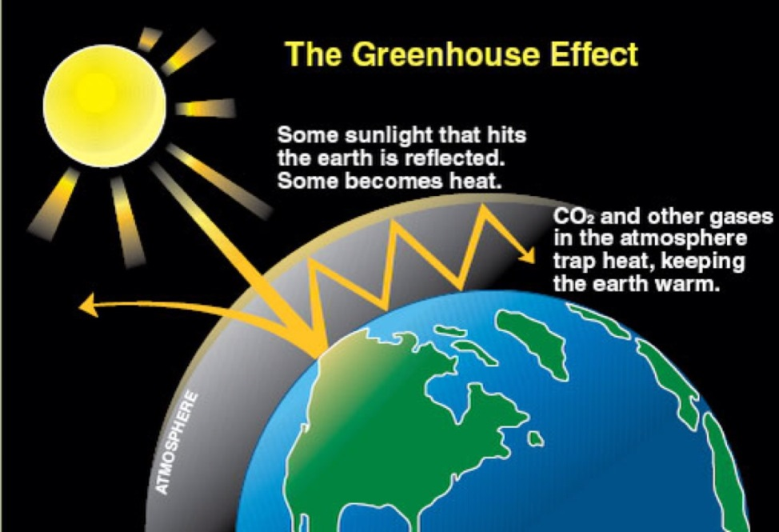
THE GREENHOUSE EFFECT
Under normal circumstances, the Sun heats the Earth’s surface and the heat is reflected back into the atmosphere.
When the levels of pollution are high, this heat , instead of escaping into space, is absorbed by the CO2 , water and other gases. This heat is then trapped on the Earth’s surface. This causes an increase of the temperature of the Earth with all its consequences.
(GLOBAL WARMING)

Slide 16
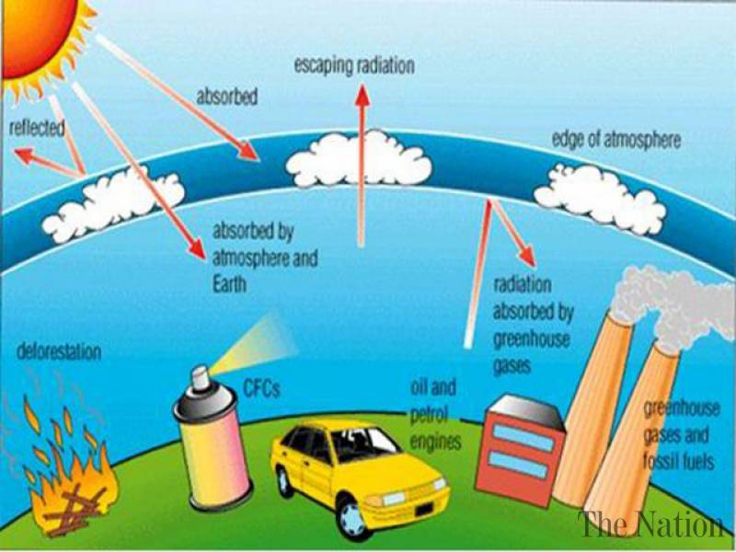
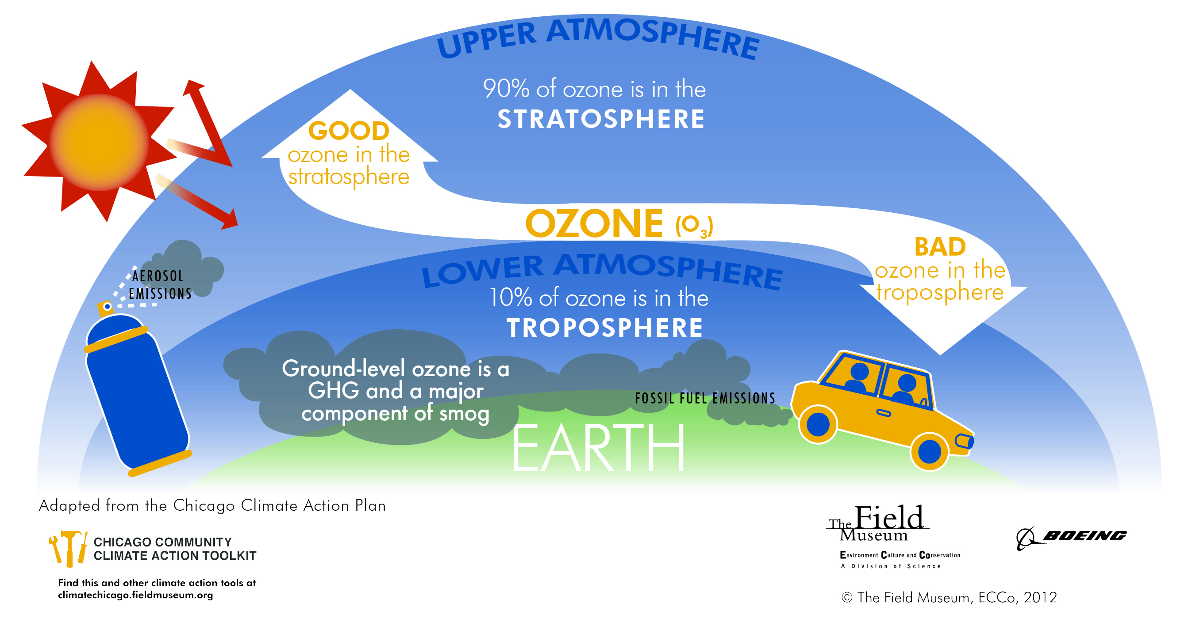
Ozone layer/Greenhouse effect

